Slide 1
Find Out How to Reduce Fuel & Maintenance Expenditures by $87K per Locomotive, And Decrease GHG Emissions, with an Idle Reduction System from ACS-RS

Slide 2
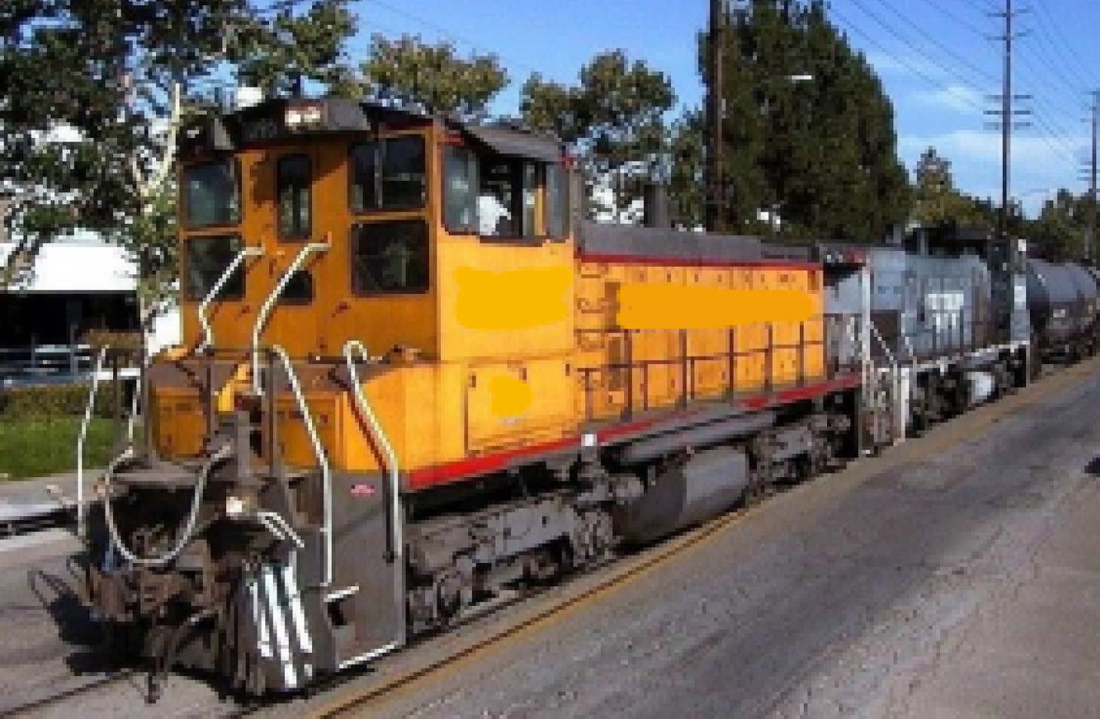
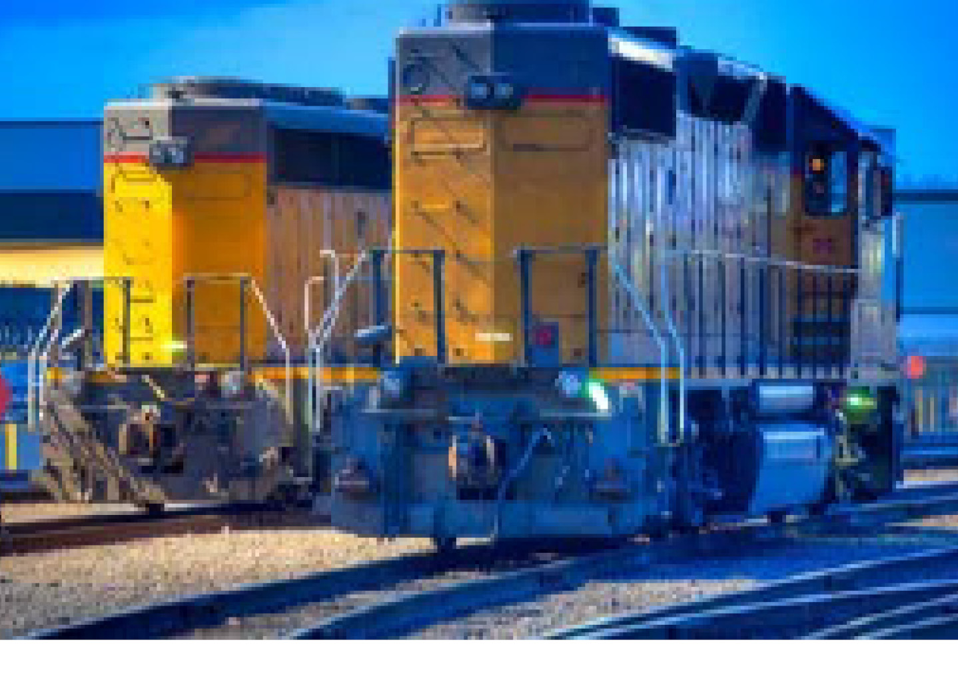
A Day in the Life of a Yard Locomotive
In Use
Parked
Moving cars around and positioning them to form a train
Typically Seven Hours Per Day
When not in use, Locomotive Engines cannot be turned off for an extend time periods:
Risk of not being able to restart due to battery discharge
A variety of on-board systems may need to remain operational
A Yard Locomotive could idle for 17 hrs/day, equating to:
87 Gallons of additional fuel use
2000+ lbs of additional GHG emissions

Slide 3
ACS Railroad Solutions Introduces the Next Generation in Idle Reduction Technology
The ACS-RS Electrolyte system provides all the functionality of an AESS, supplemented by a 33 kWH L-I Energy Module that can overcome many of the inefficiencies of a legacy AESS system

Slide 4
ACS-RS Electrolyte System Can Reduce Idle Time Between 62% - 84%
A Low Horsepower Locomotive can idle up to 4500 hours a year, based on it being in service 270 days a year/7 hours a day
Idle Reduction Time Scenarios
Scenario #1 (Worst Case) - Locomotive service time is consecutive and all systems fully powered
Locomotive systems are run off of L-I powerpack for 3.5 Hours
L-I powerpack recharges for 2.5 hours while locomotive idles
Scenario #2 (Best Case) - HVAC systems not engaged
Locomotive systems are run off of L-I powerpack for 8 Hours
L-I powerpack recharges for 2.5 hours while locomotive idles
Scenario #3 (Real World) – Locomotive Service Time is random and all systems fully powered
Locomotive systems are run off of L-I powerpack for 3.5 Hrs. or until Locomotive goes into service
L-I powerpack recharges for 2.5 hours while locomotive idles or is in Servie
In Service
Battery Powered
Idling
In Service
Battery Powered
Idling
In Service
Battery Powered
Idling
Idle Time Reduced by 10.5 Hrs (62%)
Yearly Fuel & Maintenance Savings of $81K (@ $4.00/gal)
Idle Time Reduced by 14.2 Hrs (84%)
Yearly Fuel & Maintenance Savings of $107K (@ $4.00/gal)
Idle Time Reduced by 11.4 Hrs (67%)
Yearly Fuel & Maintenance Savings of $87K (@ $4.00/gal)
Battery Power and Recharge Times Based on Norfolk Southern Pilot Program

Slide 5
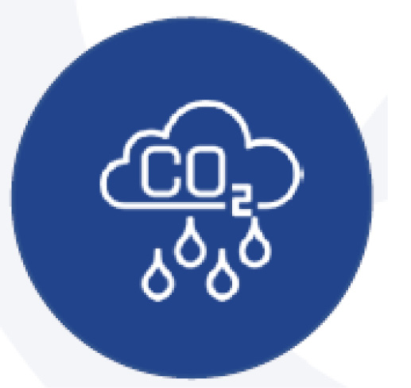
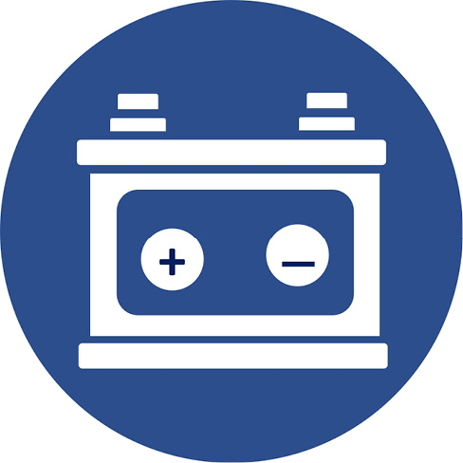
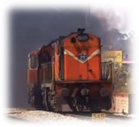
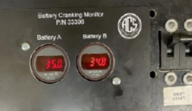
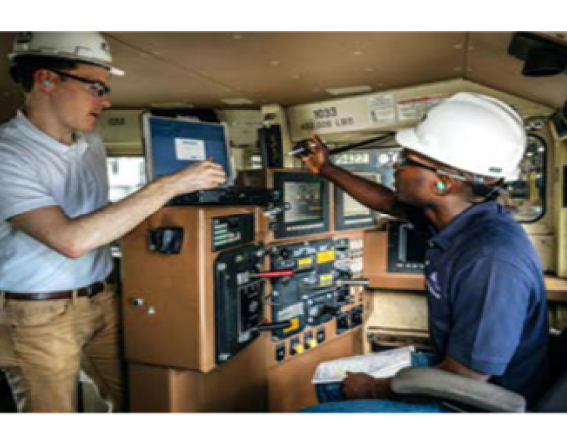
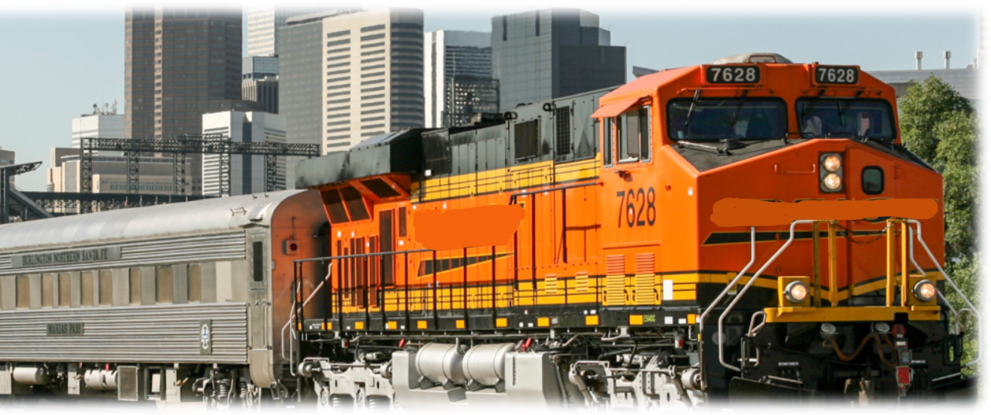
The ACS-RS Electrolyte Power System Also Provides a Variety of Non-Financial Benefits
Reduced Green House Gas Emissions
More Reliable Engine Starts
Enhanced Crew Comfort & Safety/Improved Community Relations
Proportional decrease in both running and cold start emissions (Approx 2000 lbs./day)
Reduction in:
ACS-RS Electrolyte Power System trickle charges the Lead Acid Batteries so they are ready to go when the Locomotive needs to restart
For optimum results, pair with the ACS-RS Battery Cranking Monitor to provide in-cab display of battery voltage levels
Crew can continually operate in a temperature controlled environment
Walkway, Steps and Cab fully lighted to improve safety
CIC and TIR systems continue to operate
Reduce noise and odorous emissions for the surrounding communities
NOX
CO
CO2
SO2
CH4
O3
Reduction in other EPA regulated pollutants
Unburned Diesel Fuel
Engine oil slip into exhaust

Slide 6
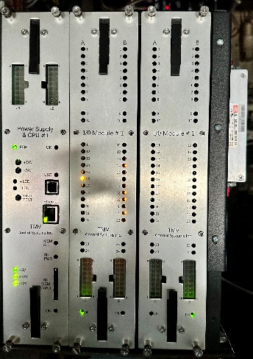
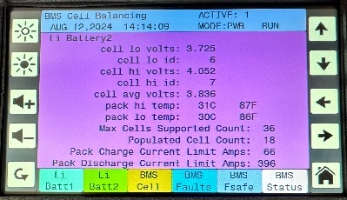
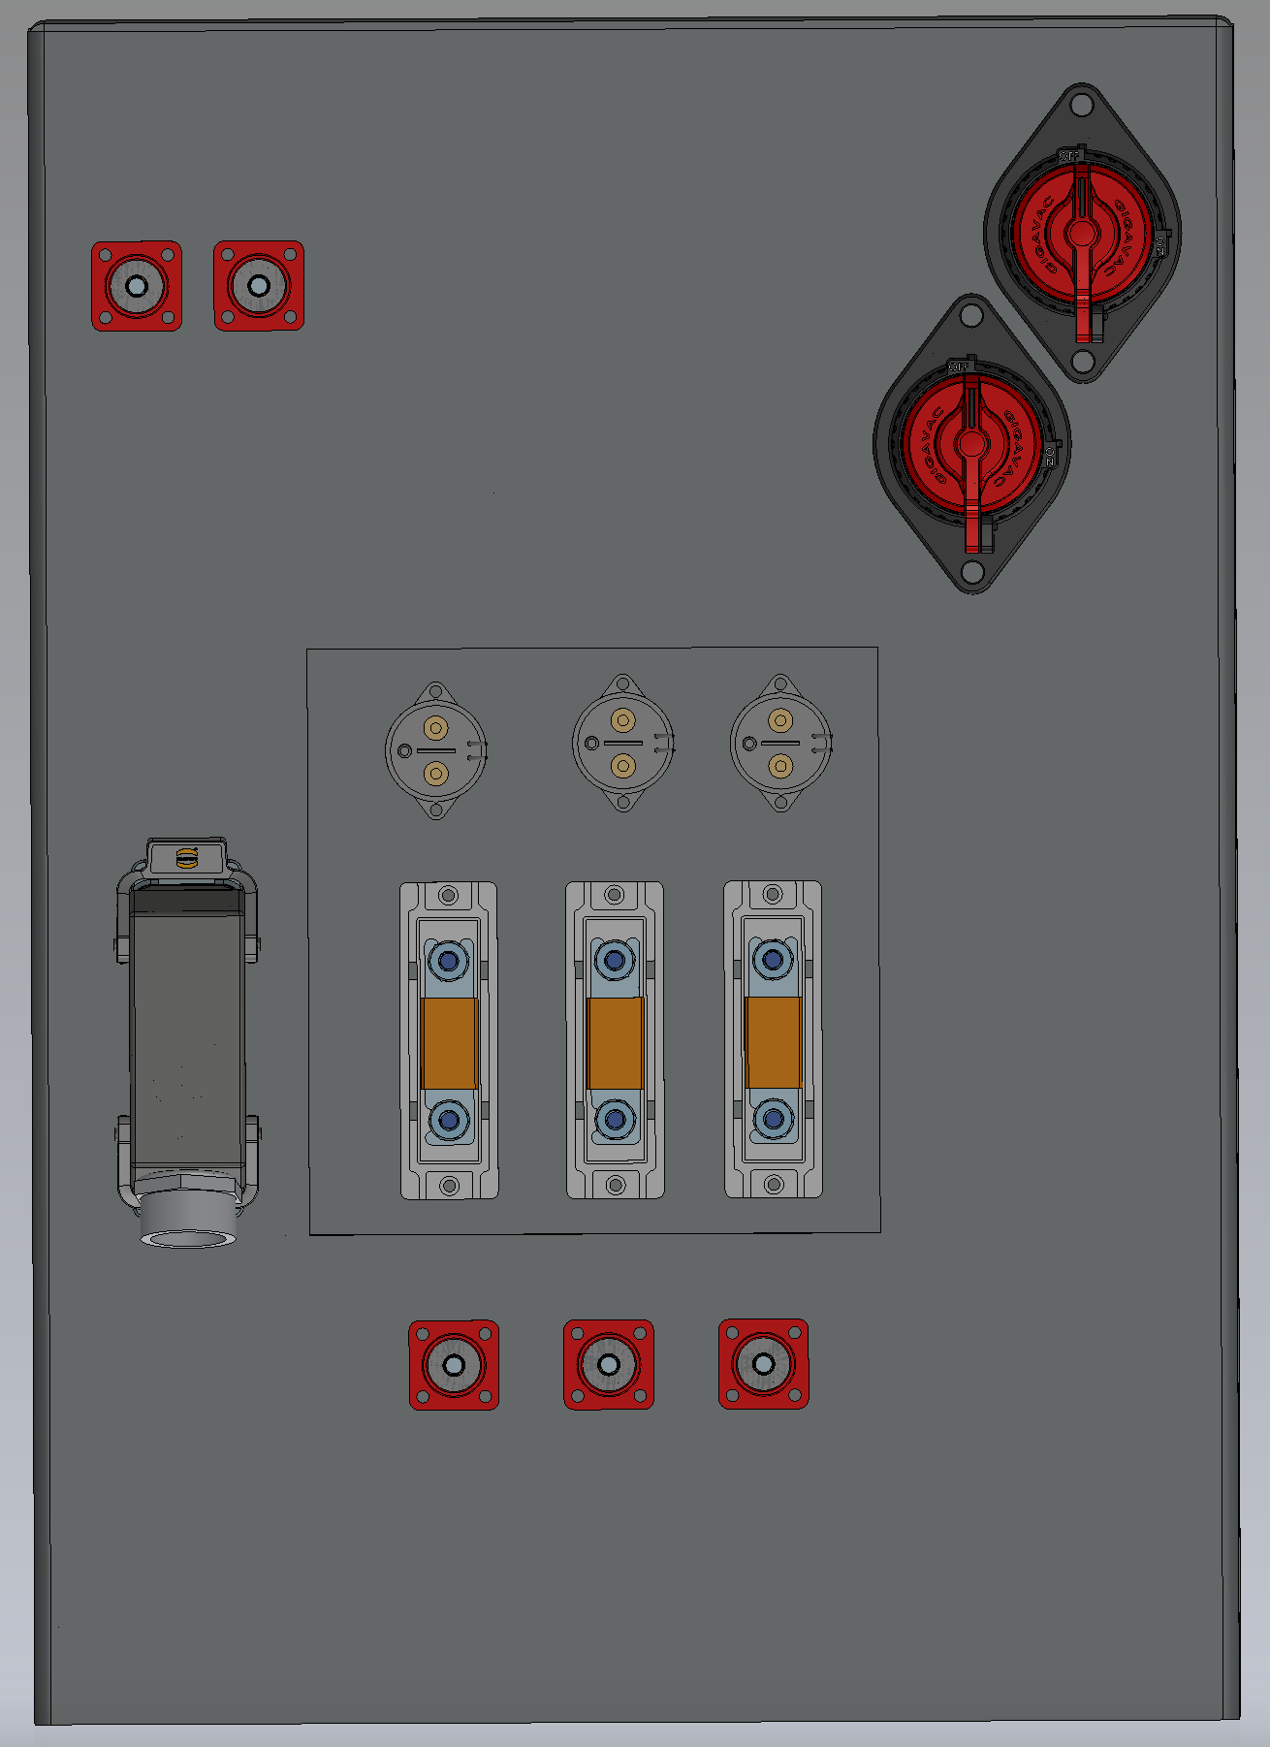
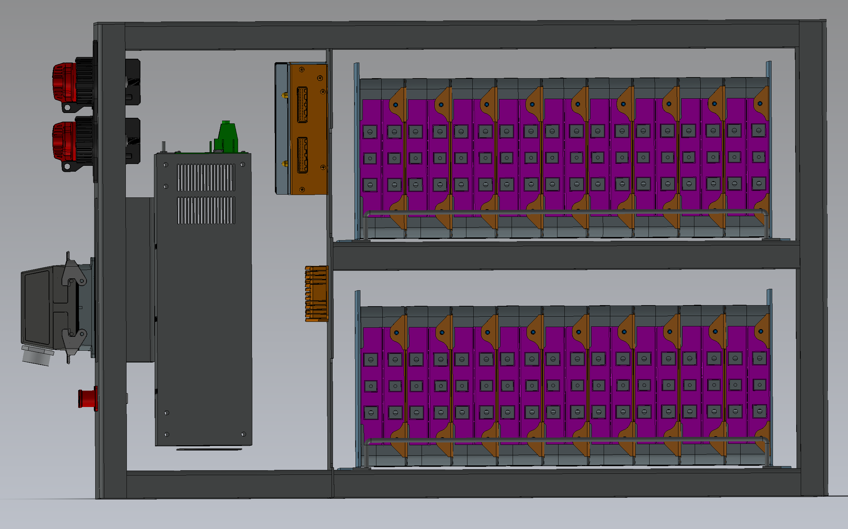
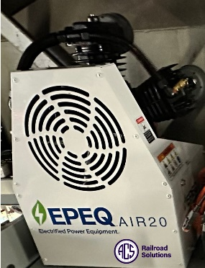
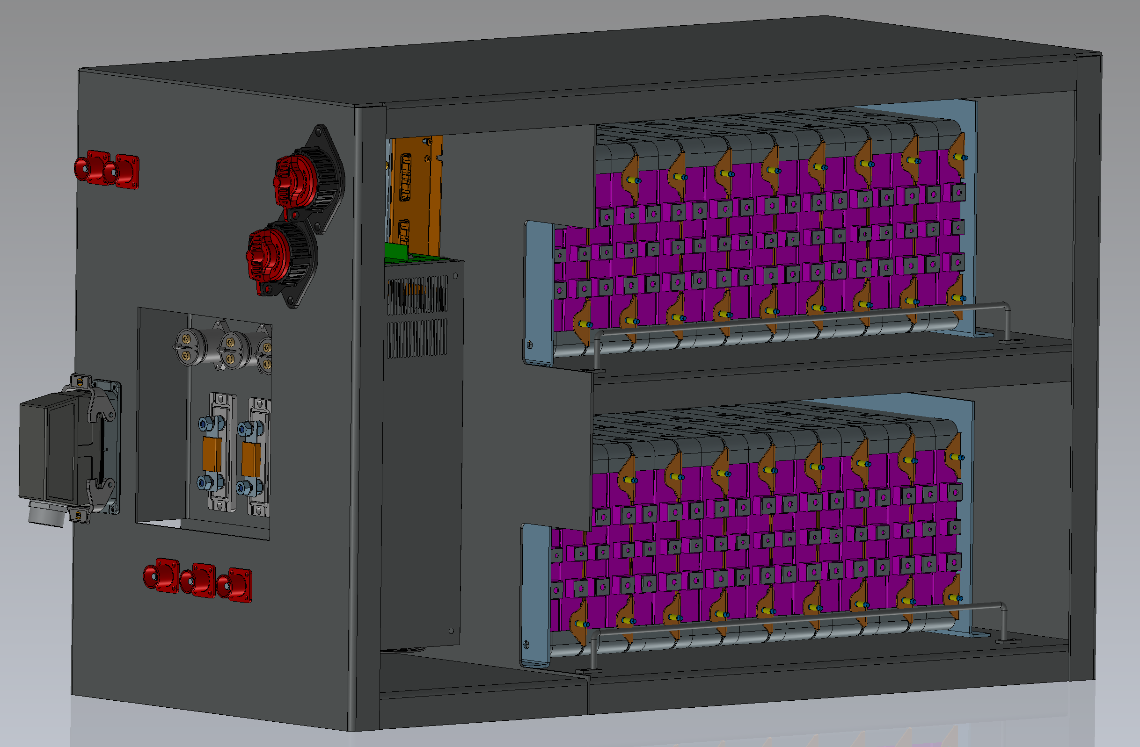
Simple & Clean Integration Into Your Locomotive Using Industrially Hardened Components
Locomotive Control System Mounts in the Cab Electrical Cabinet
L-I Battery Energy Module and Make-up Air Compressor Mount in the Sandbox in the Long Hood of the Locomotive
The 33 kWH Energy Module is comprised of 18 individual battery cards which are mounted in series inside of an industrial enclosure
The enclosure has heating and cooling capability to ensure the Energy Module operates within its optimum temperature range
Make-Up Air compressor is powered via the energy module
Cabinet is internally wired to applicable industrial grade quick disconnects to facilitate easy installation and maintenance.

Slide 7
Based on Technology Proven in Other Harsh-Duty Applications
Idle Mitigation
Remote Power
Ambulances
Tug-Boats
Earth Moving Equipment
Irrigation Systems

